Slide 1
Airbnb Analysis - based on Southbank Area, Melbourne
AD 699 Data Mining for Business Analytics
Instructor: Greg Page Presented by: Dandan Zeng Haoran Zhang
Kaming Yip Yueyue Li Alan Lee Date: December 10, 2019

Slide 2
Agenda
Project Overview
Data Preparation & Exploration
Predication
Neighborhood Introduction
Project Goal and Objectives
Missing Values
Visualization
Multiple Regression
Classification
Clustering
Conclusion
K- nearest neighbors
Naive Bayes
Classification Tree
K-mean Analysis
Overview
Outlook

Slide 3
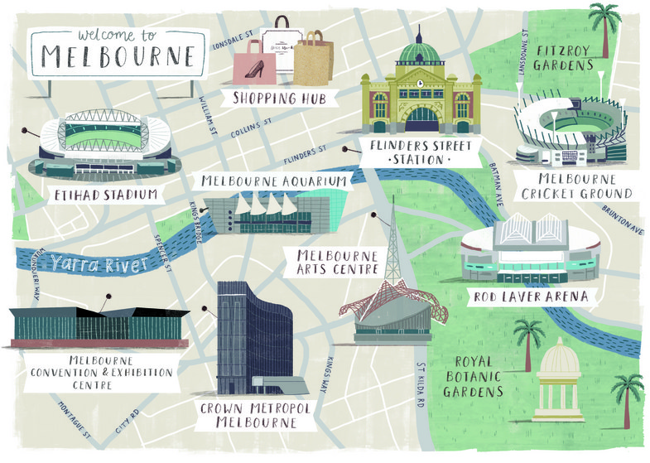
Project Overview
Neighborhood Introduction
“Southbank is an inner urban neighbourhood of Melbourne, Victoria, Australia. Its local government area are the cities of Melbourne and Port Phillip. Its southernmost area is considered part of the CBD of the city. Southbank Promenade and Southgate Restaurant and Shopping Precinct, on the southern bank of the Yarra River, extending to Crown Casino, is one of Melbourne's major entertainment precincts.”
---------- Wikipedia
Southbank
Notes:
40s

Slide 4
Data Preparation & Exploration
1

Slide 5
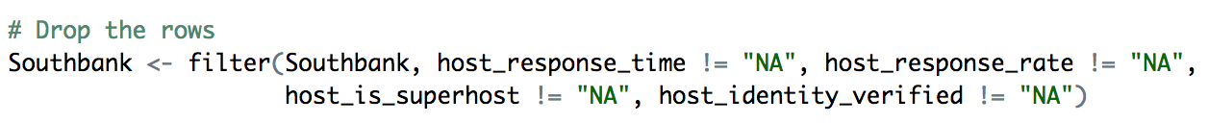
Missing Values
Method 1: Drop the N/A rows
Method 2: Imputation
Security_deposit ------ “0”
Cleaning_fee ------ “0”
Review_score_rating ------ “median”
Review_score_accuracy ------ “median”
Notes:
In most of the cases in this project, imputation, instead of deleting whether a specific column or several rows, is one of the most prevailing methods to handle the missing values

Slide 6
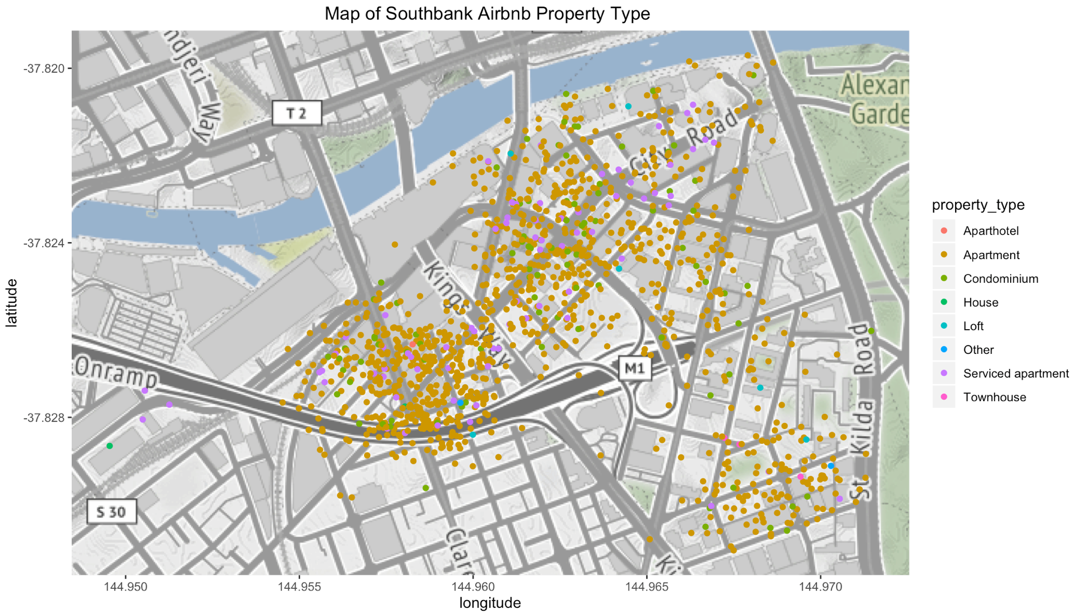
Visualization
Plot 1: map

Slide 7
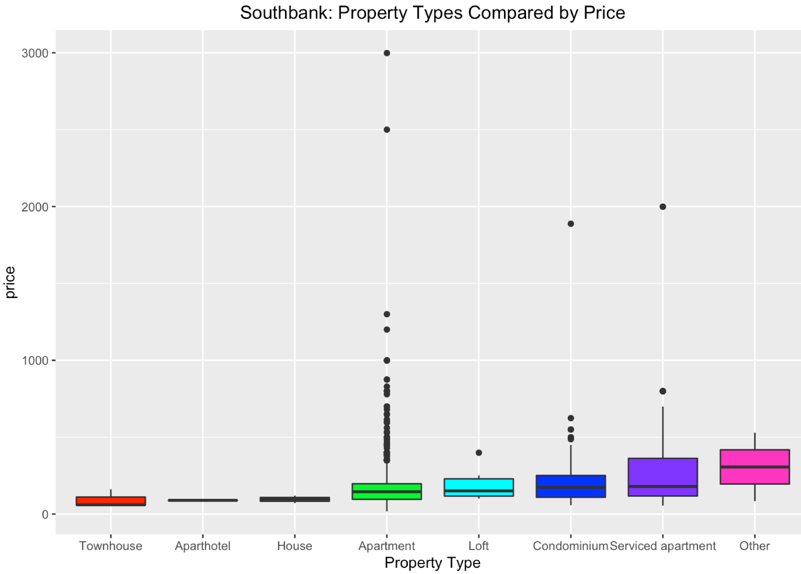
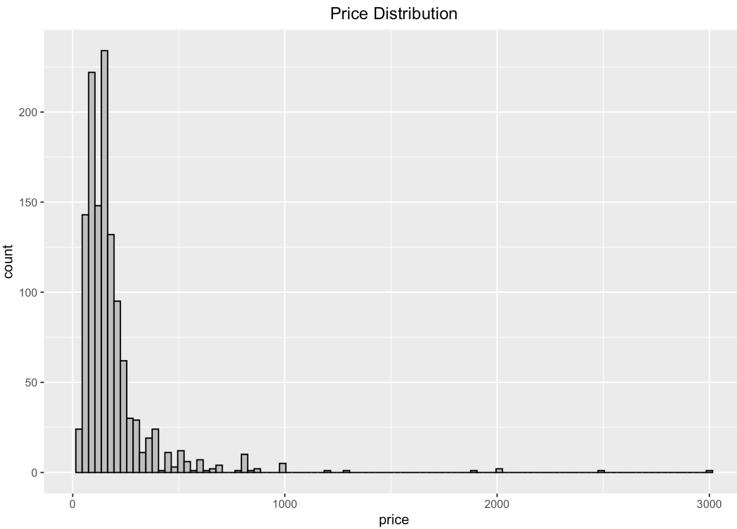
Plot 3: Histogram
Visualization
Plot 2: Boxplot

Slide 8
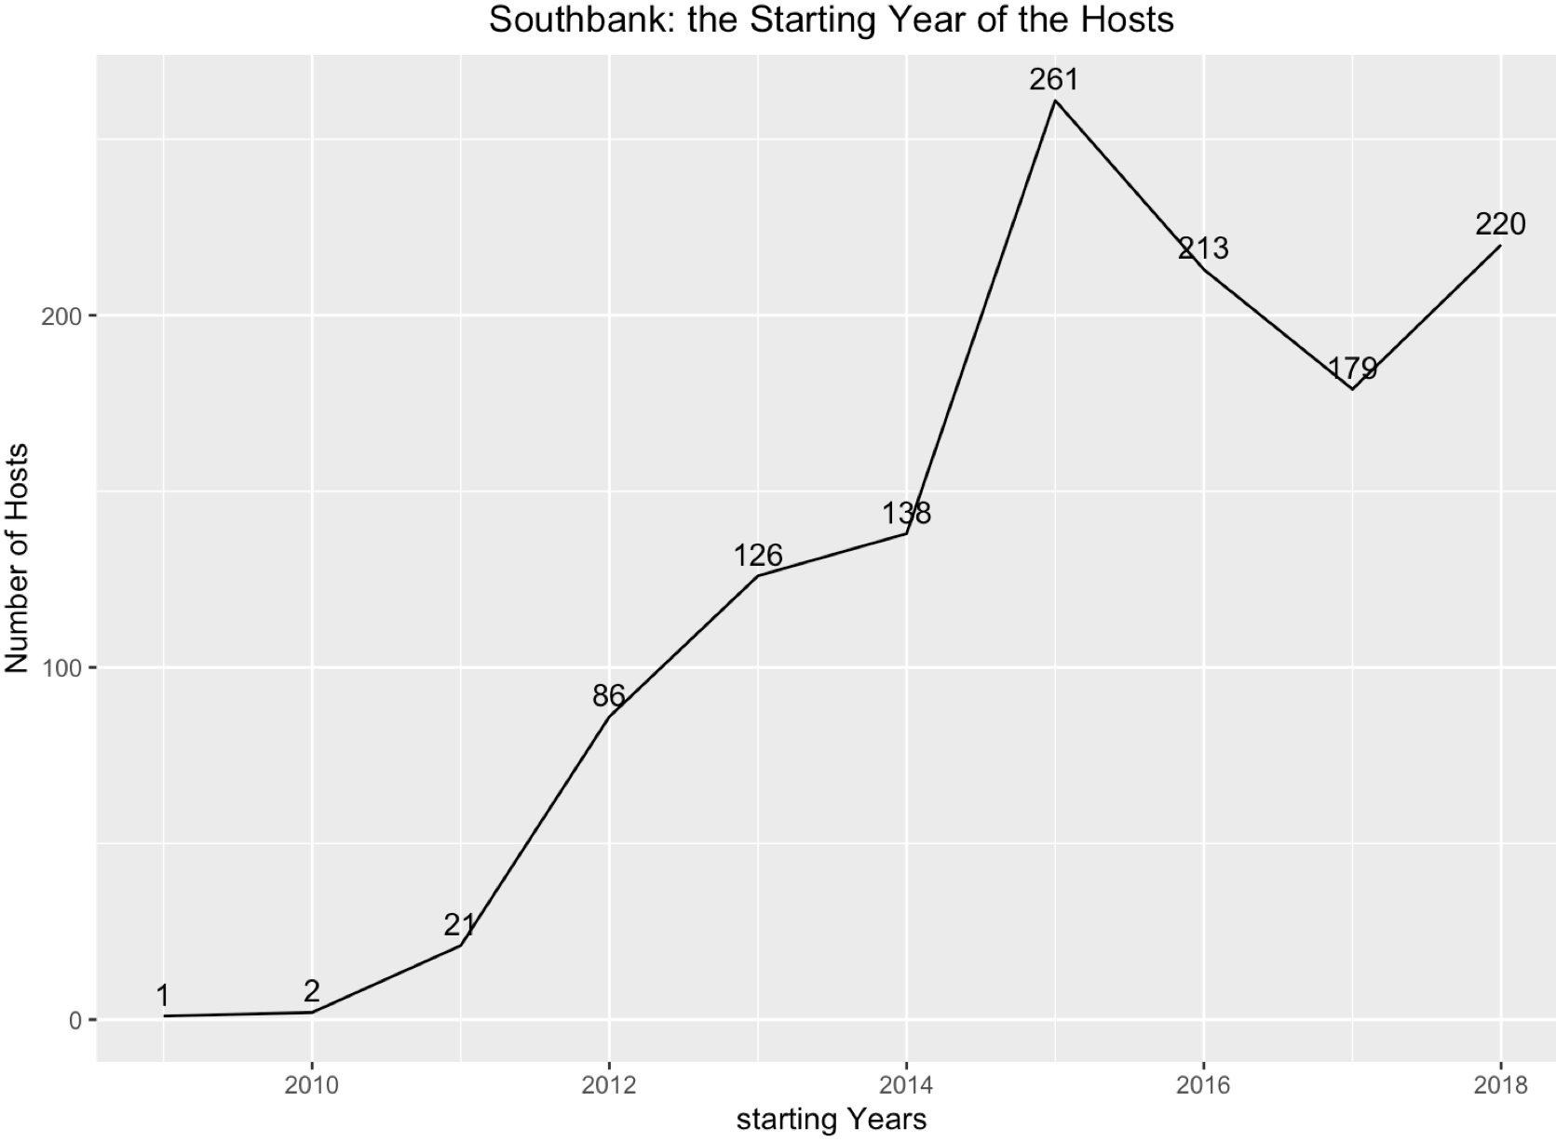
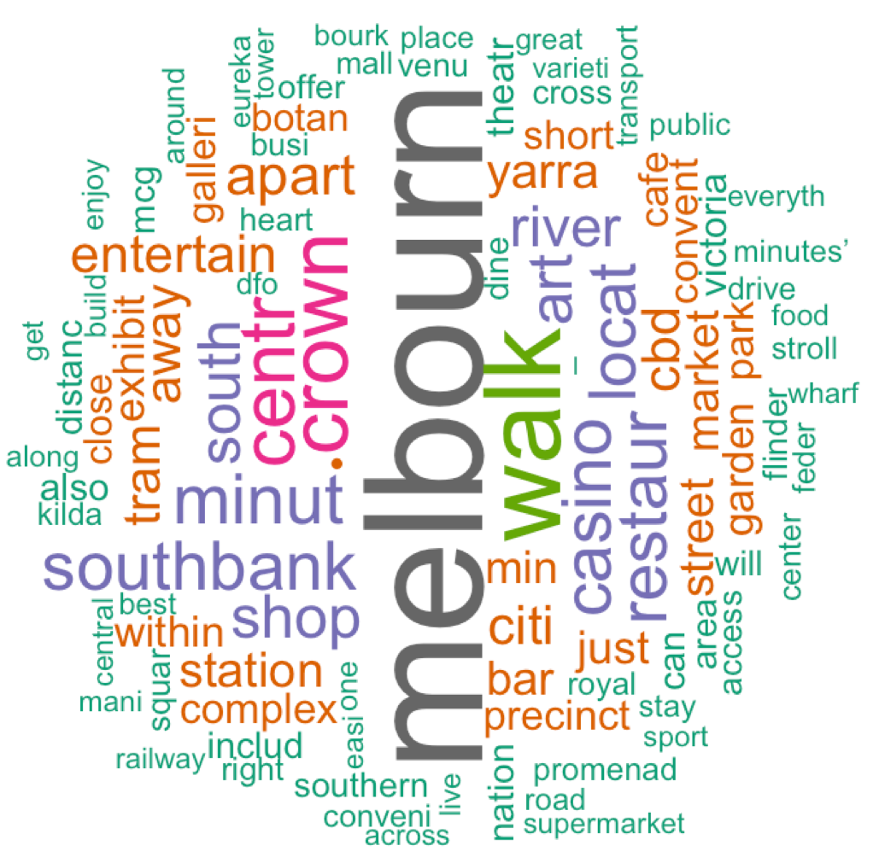
Visualization
Plot 4: line
Plot 5: word cloud
Notes:
40s

Slide 9
Prediction
2

Slide 10
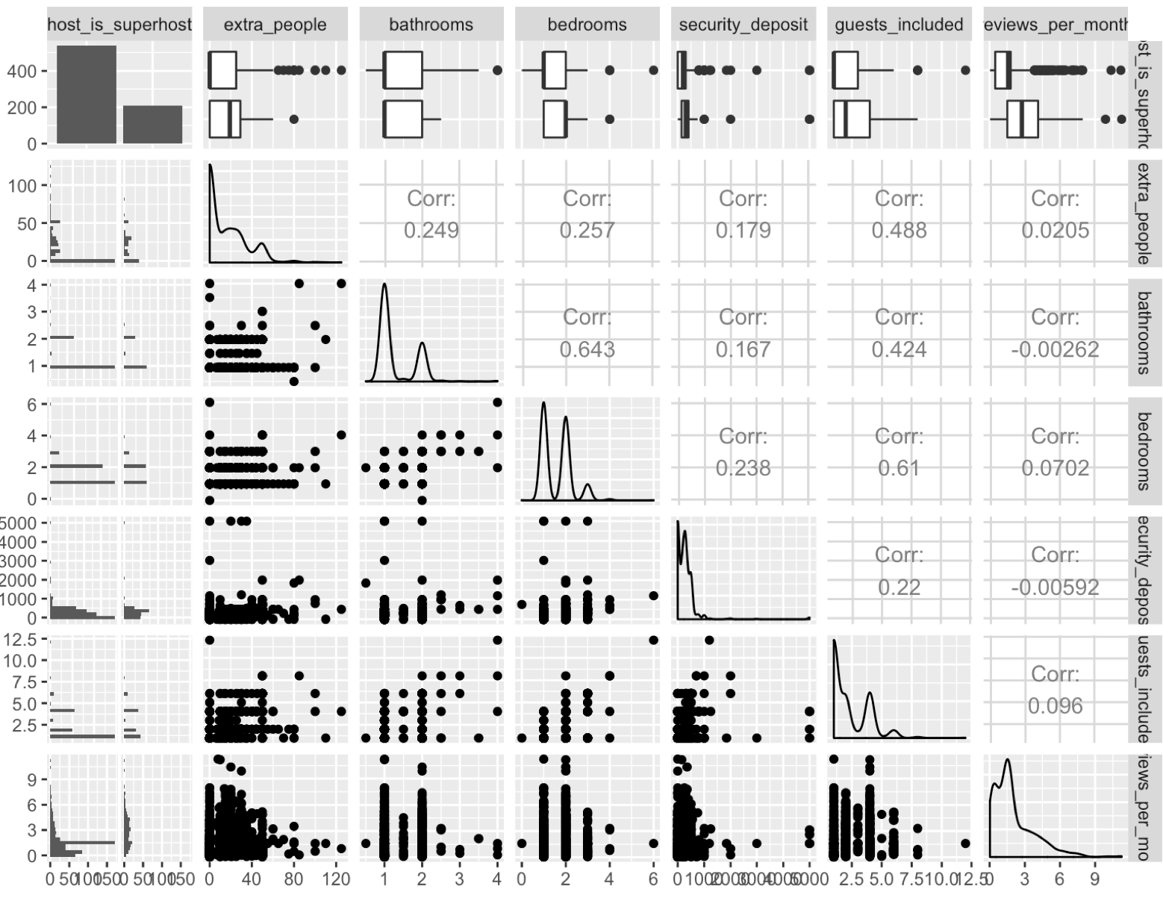
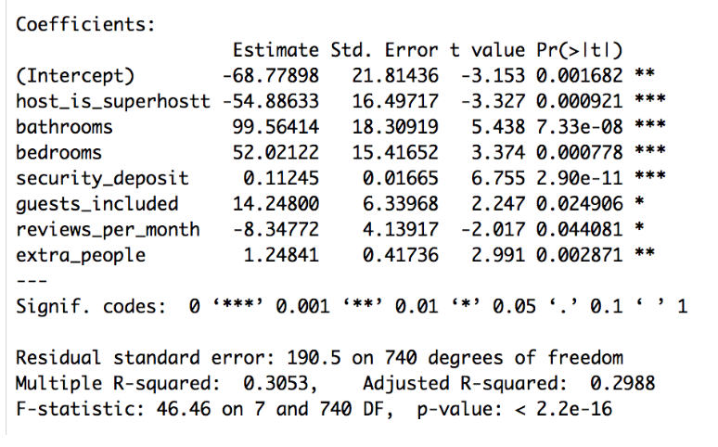
Prediction
Multiple Linear Regression
Selecting Significant Predictors
Backward elimination
Final Predictors

Slide 11
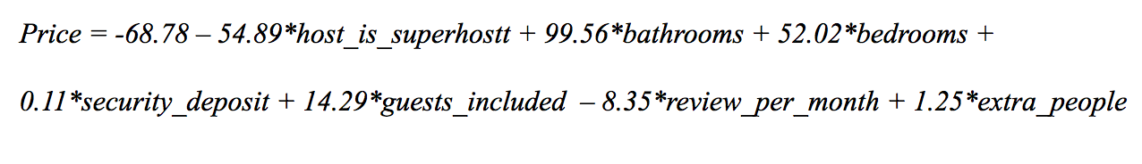
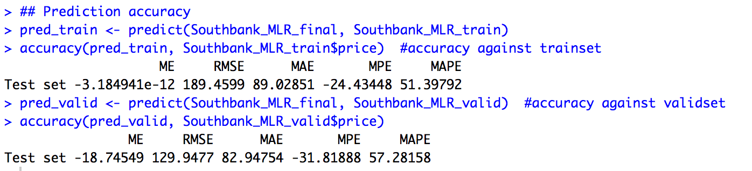
Prediction
Multiple Linear Regression
Regression Equation
Accuracy
Notes:
1 min

Slide 12
Classification
3

Slide 13
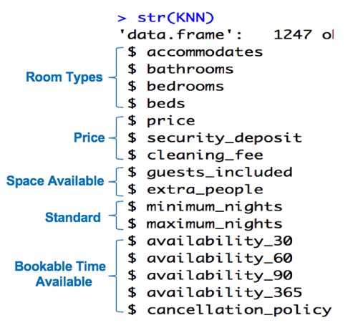
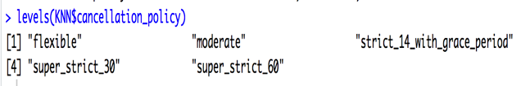
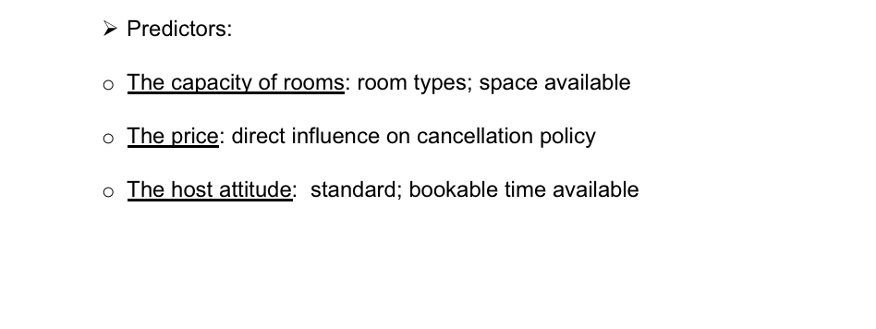
Classification
k-nearest Neighbors
Predict Cancellation Policy

Slide 14
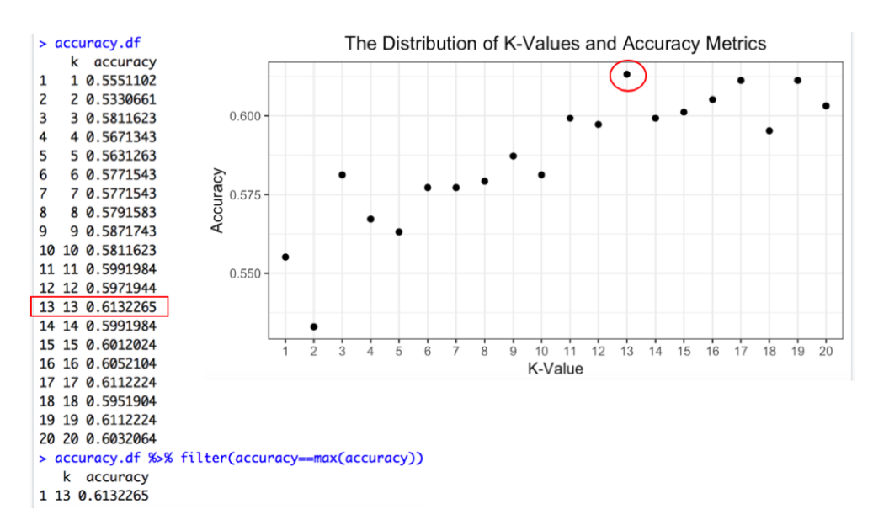
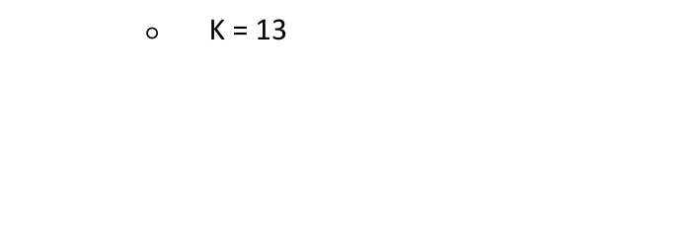
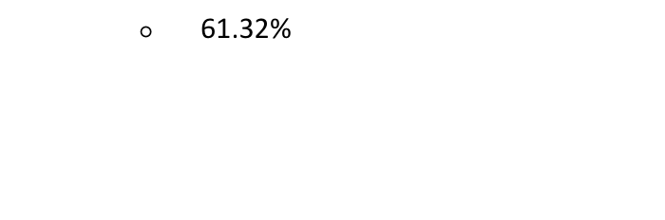
Classification
k-nearest Neighbors
Optimal K-Value
Highest Accuracy

Slide 15
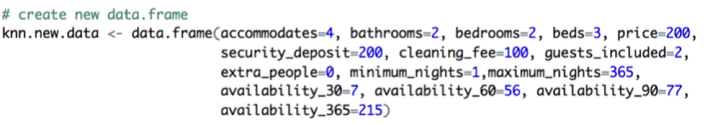
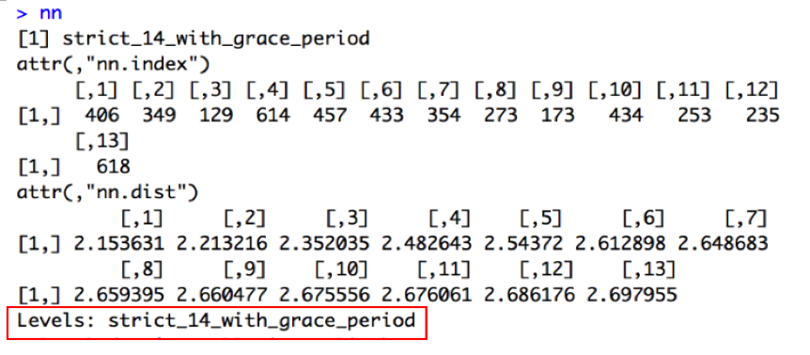
Classification
k-nearest Neighbors
Create Test Neighborhood
Test Neighborhood
Notes:
2min

Slide 16
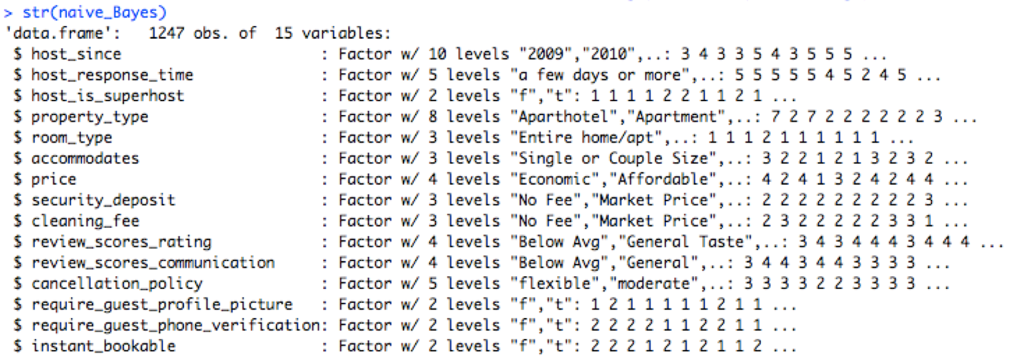
Classification
Naive Bayes
Data Preprocessing:
Bin the numerical predictors and convert them to categorical predictors

Slide 17
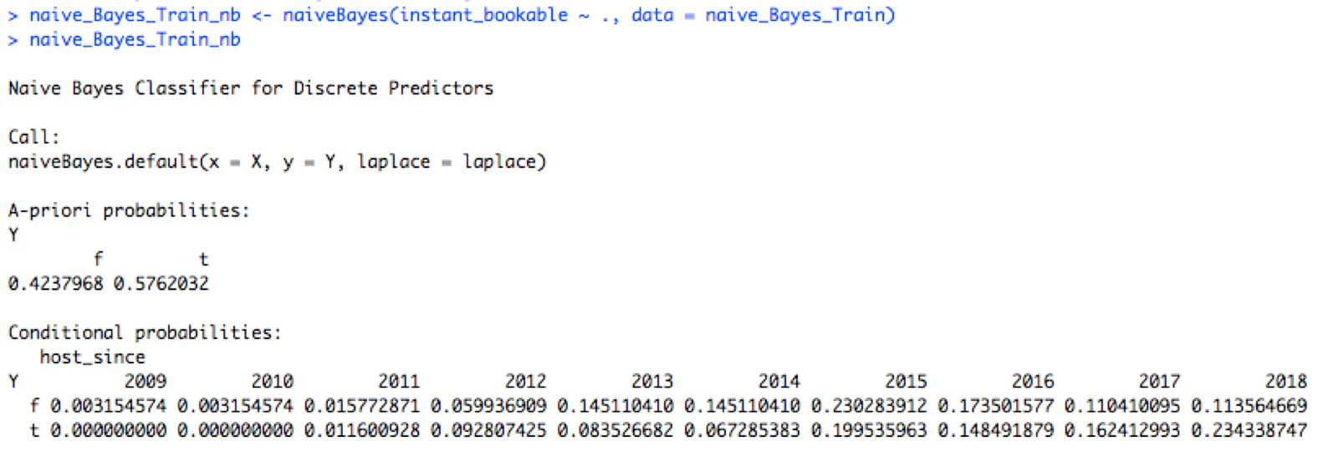
Classification
Naive Bayes
After data partition:
Build a Naive Bayes Model against training data
(partial result)

Slide 18
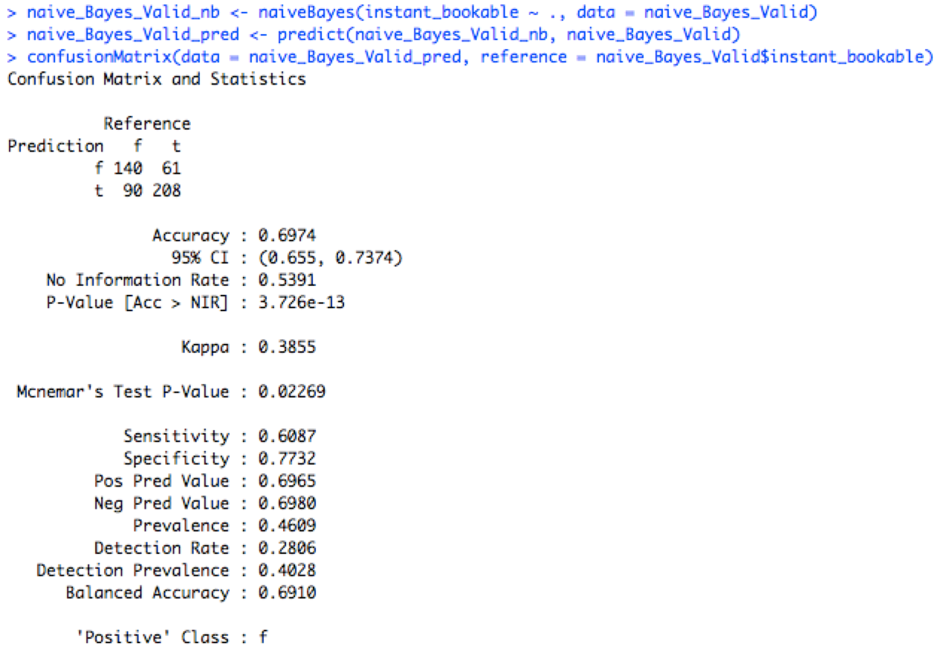
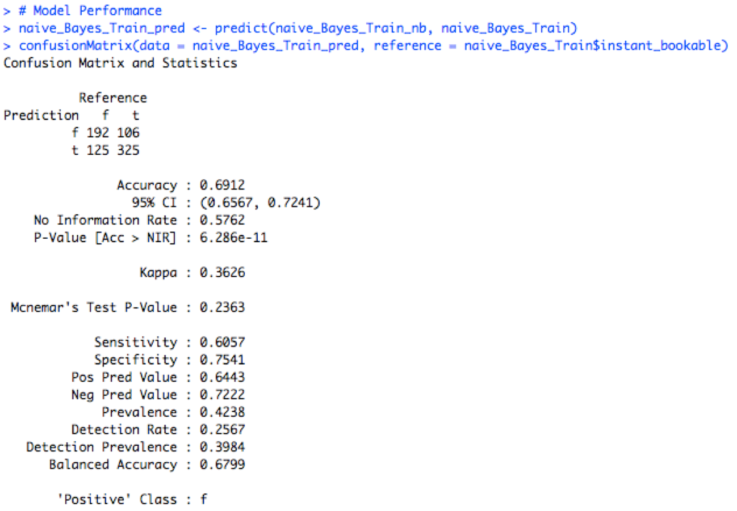
Classification
Naive Bayes
Model Assessment: Confusion Matrix
Training Data:
accuracy: 0.6912
sensitivity: 0.6057
Specificity: 0.7541
Pos Pred Value: 0.6443
Neg Pred Value:0.7222
Validation Data:
accuracy: 0.6974
sensitivity: 0.6087
Specificity: 0.7732
Pos Pred Value: 0.6965
Neg Pred Value:0.6980

Slide 19
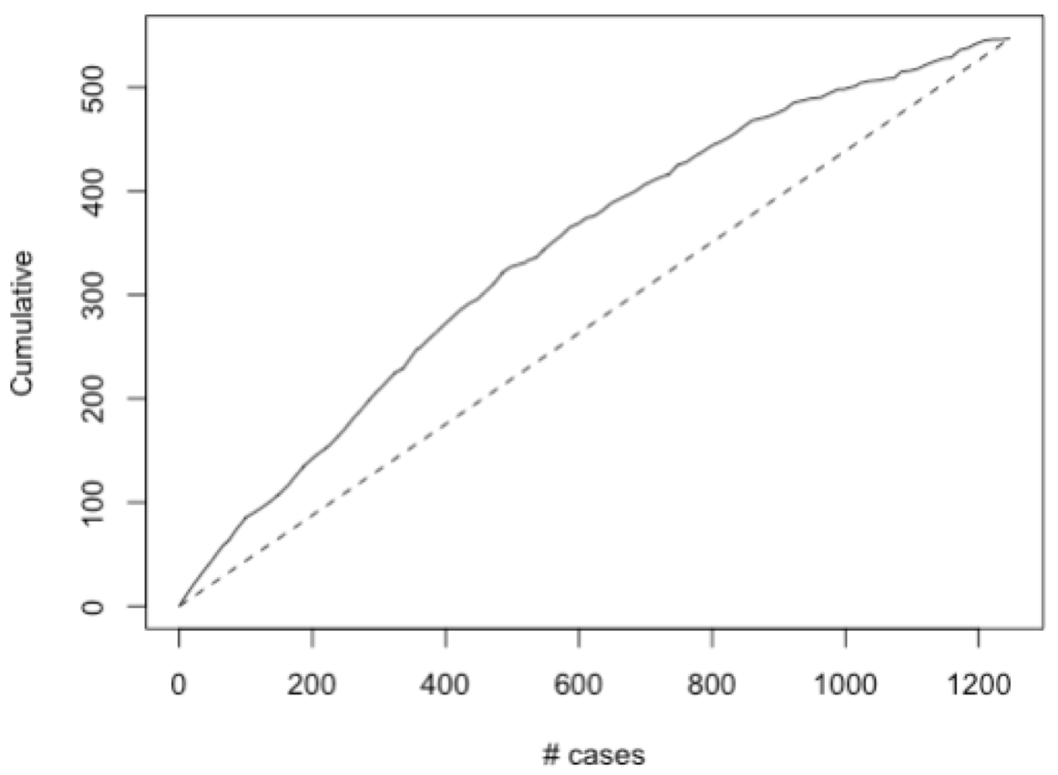
Classification
Naive Bayes
Model Assessment: Lift Chart

Slide 20
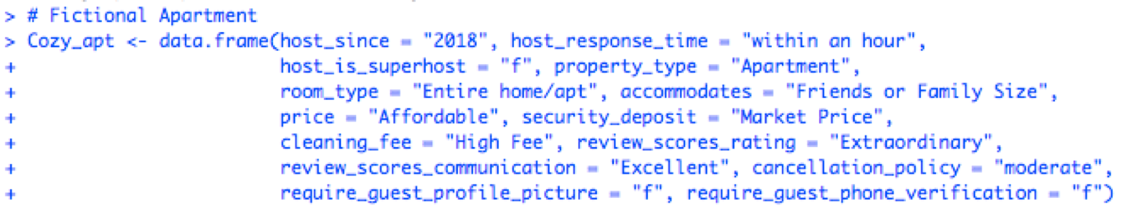
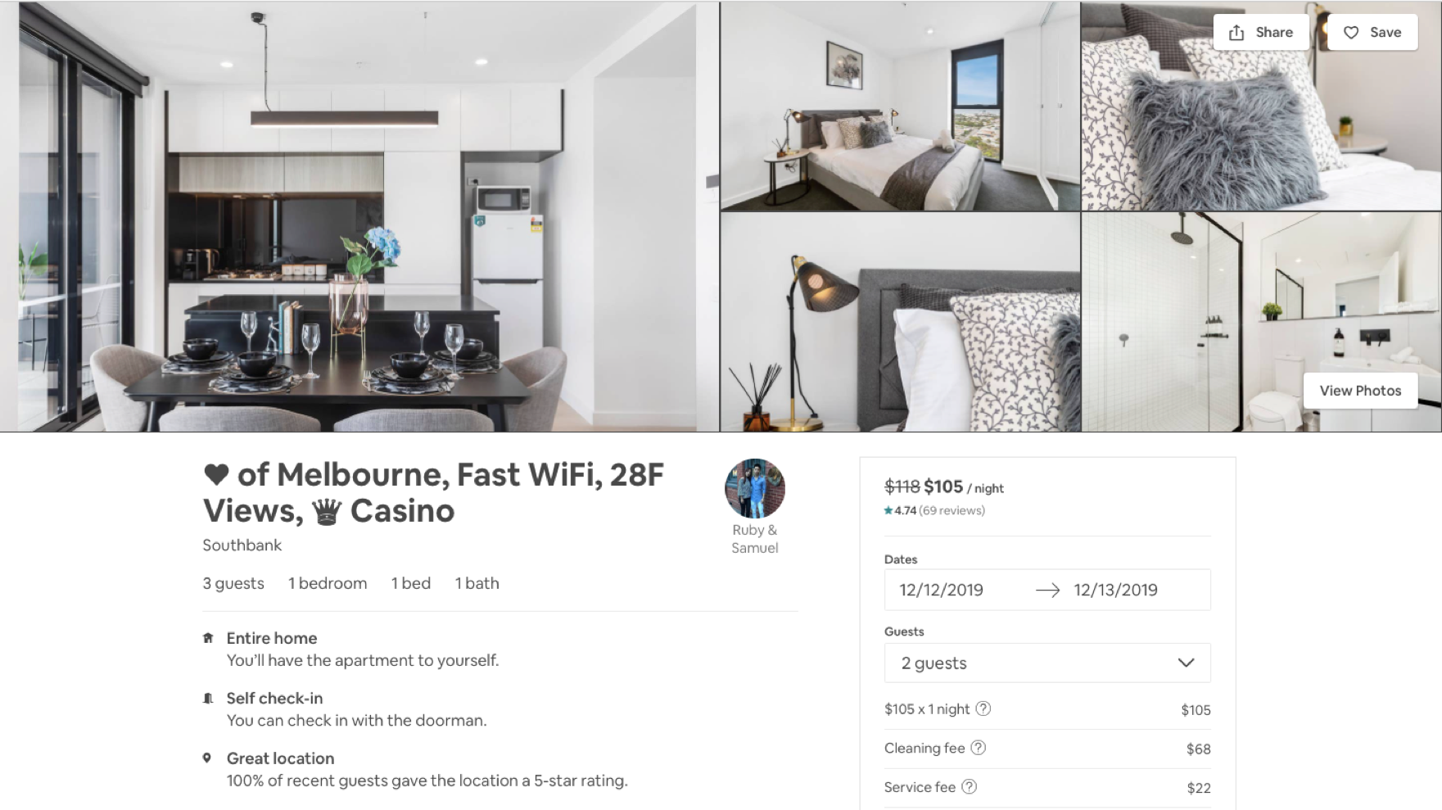
Classification
Naive Bayes
Model Testing: a fictional apartment

Slide 21
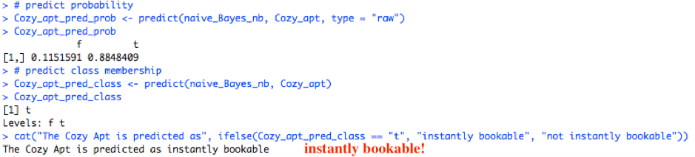
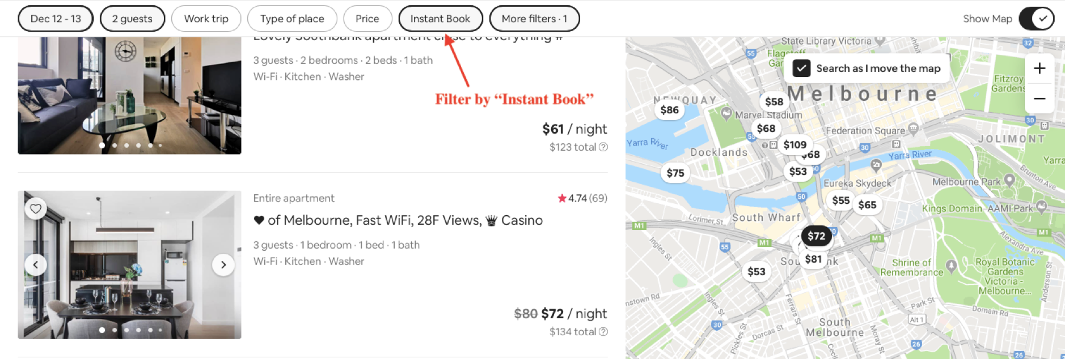
Classification
Naive Bayes
Model Testing: a fictional apartment
Happy to see the model gives out the same "decision" as the hosts Ruby & Samuel!
Notes:
2min30s

Slide 22
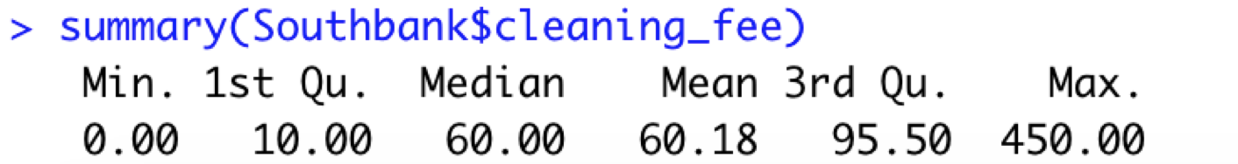

Classification
Classification Tree
4 groups: No Fee (-0.1, 0.1)
Low (0.1, 35)
Moderate (35, 60)
High (60, 450)

Slide 23
Classification
Classification Tree
Price,
Extra_people
Review_scores_cleanliness
Property type, room type, bathrooms, bedrooms, beds
accommodates
guests_include

Slide 24
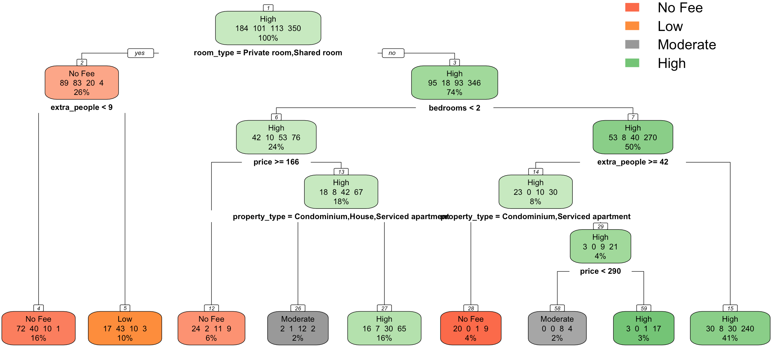
Classification
Classification Tree - First trial

Slide 25
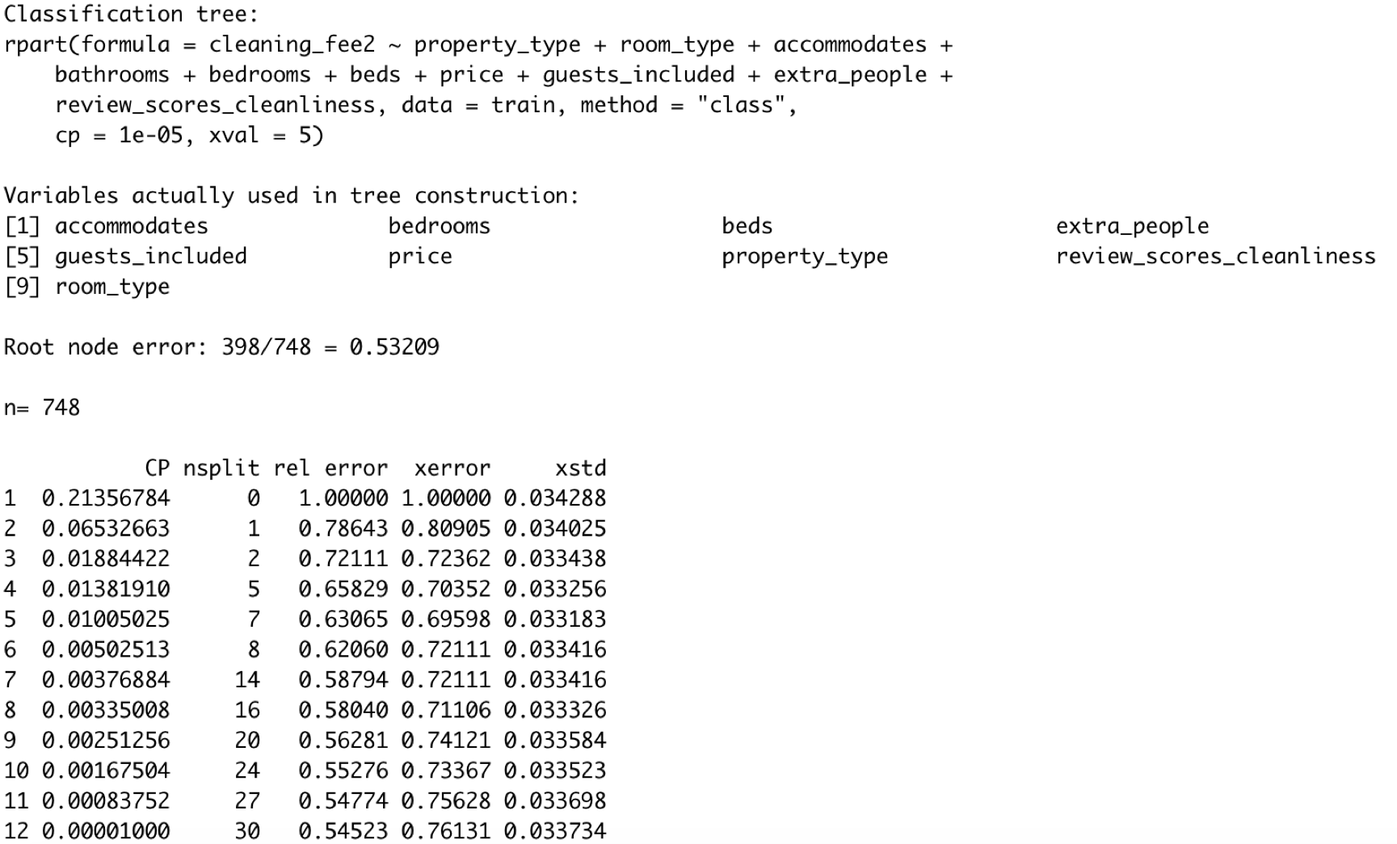
Classification
Classification Tree
cp=0.01005025

Slide 26
Classification
Classification Tree - with ideal size
No Change

Slide 27
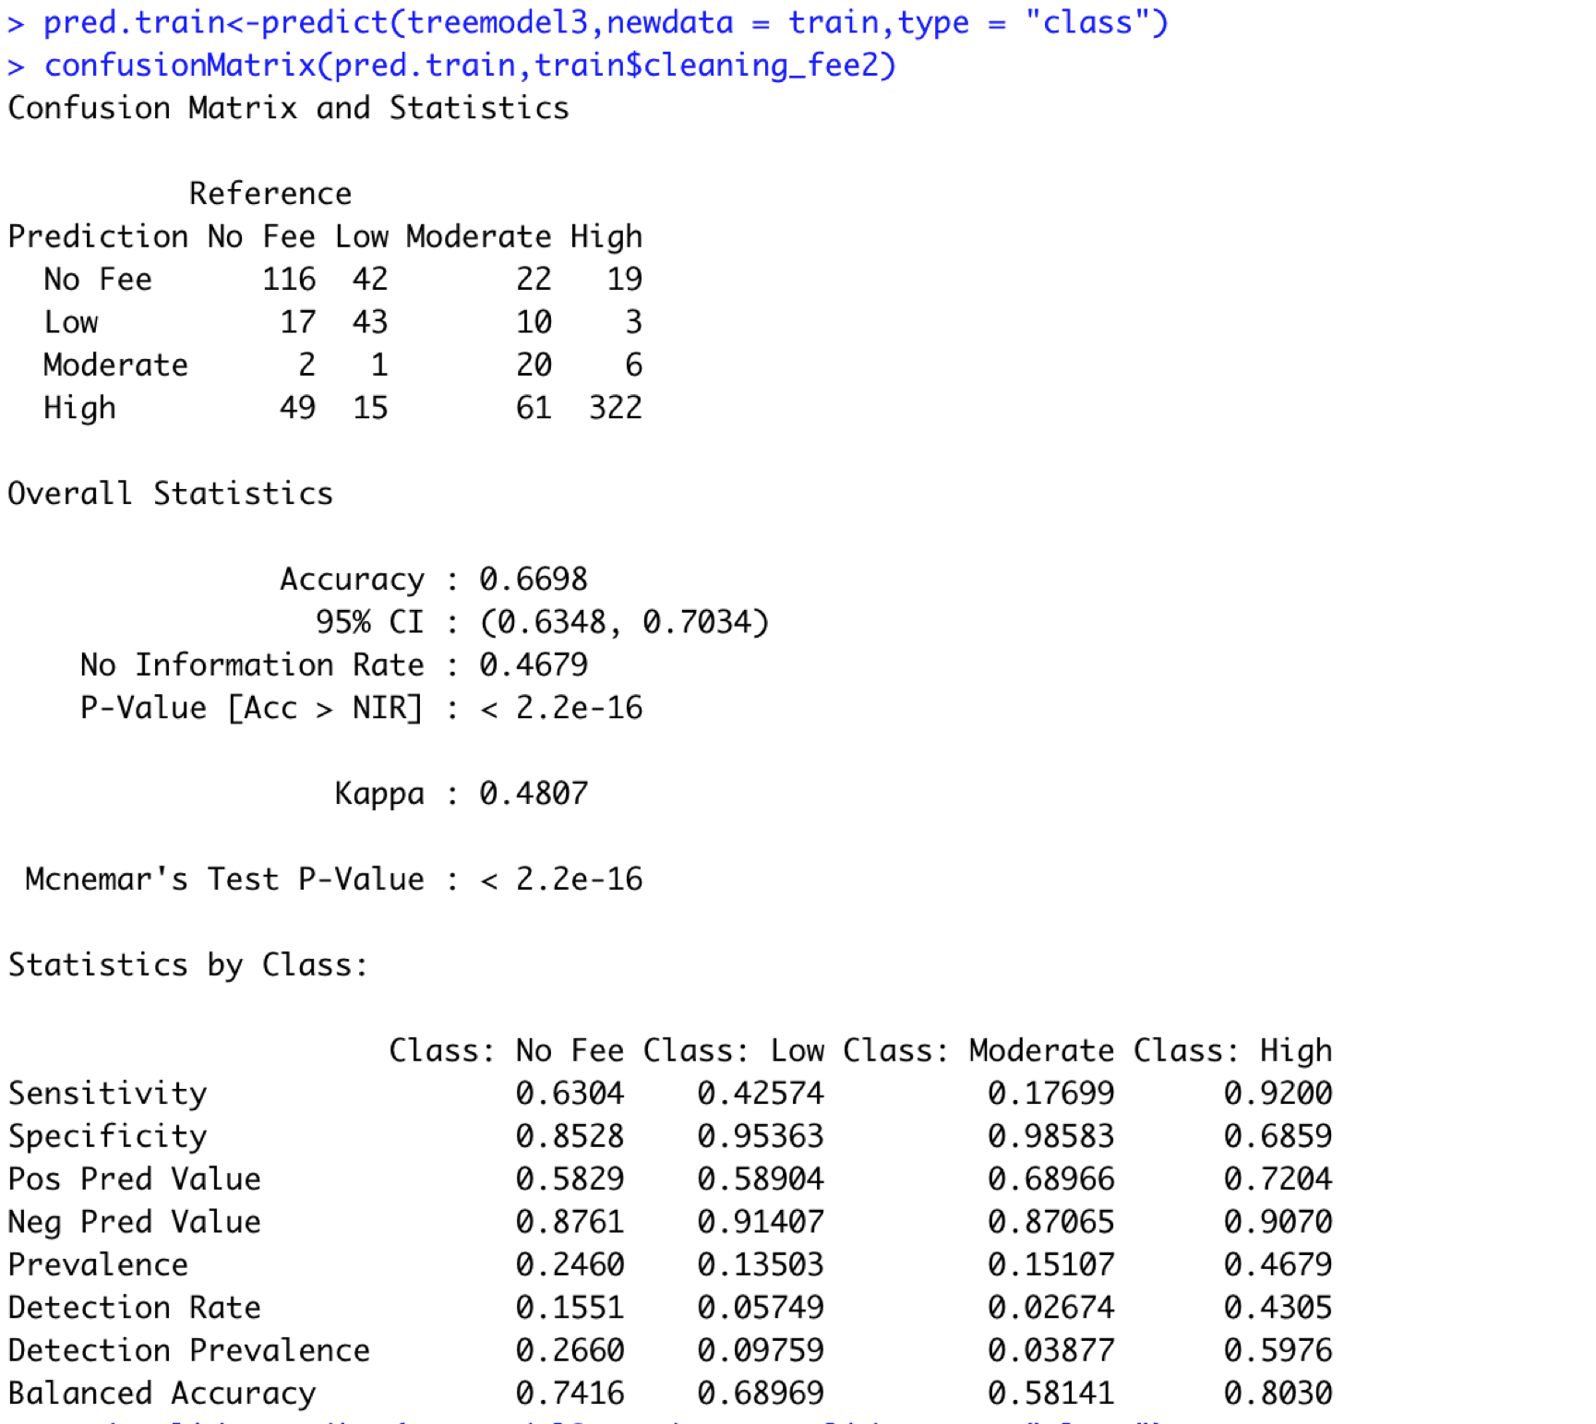
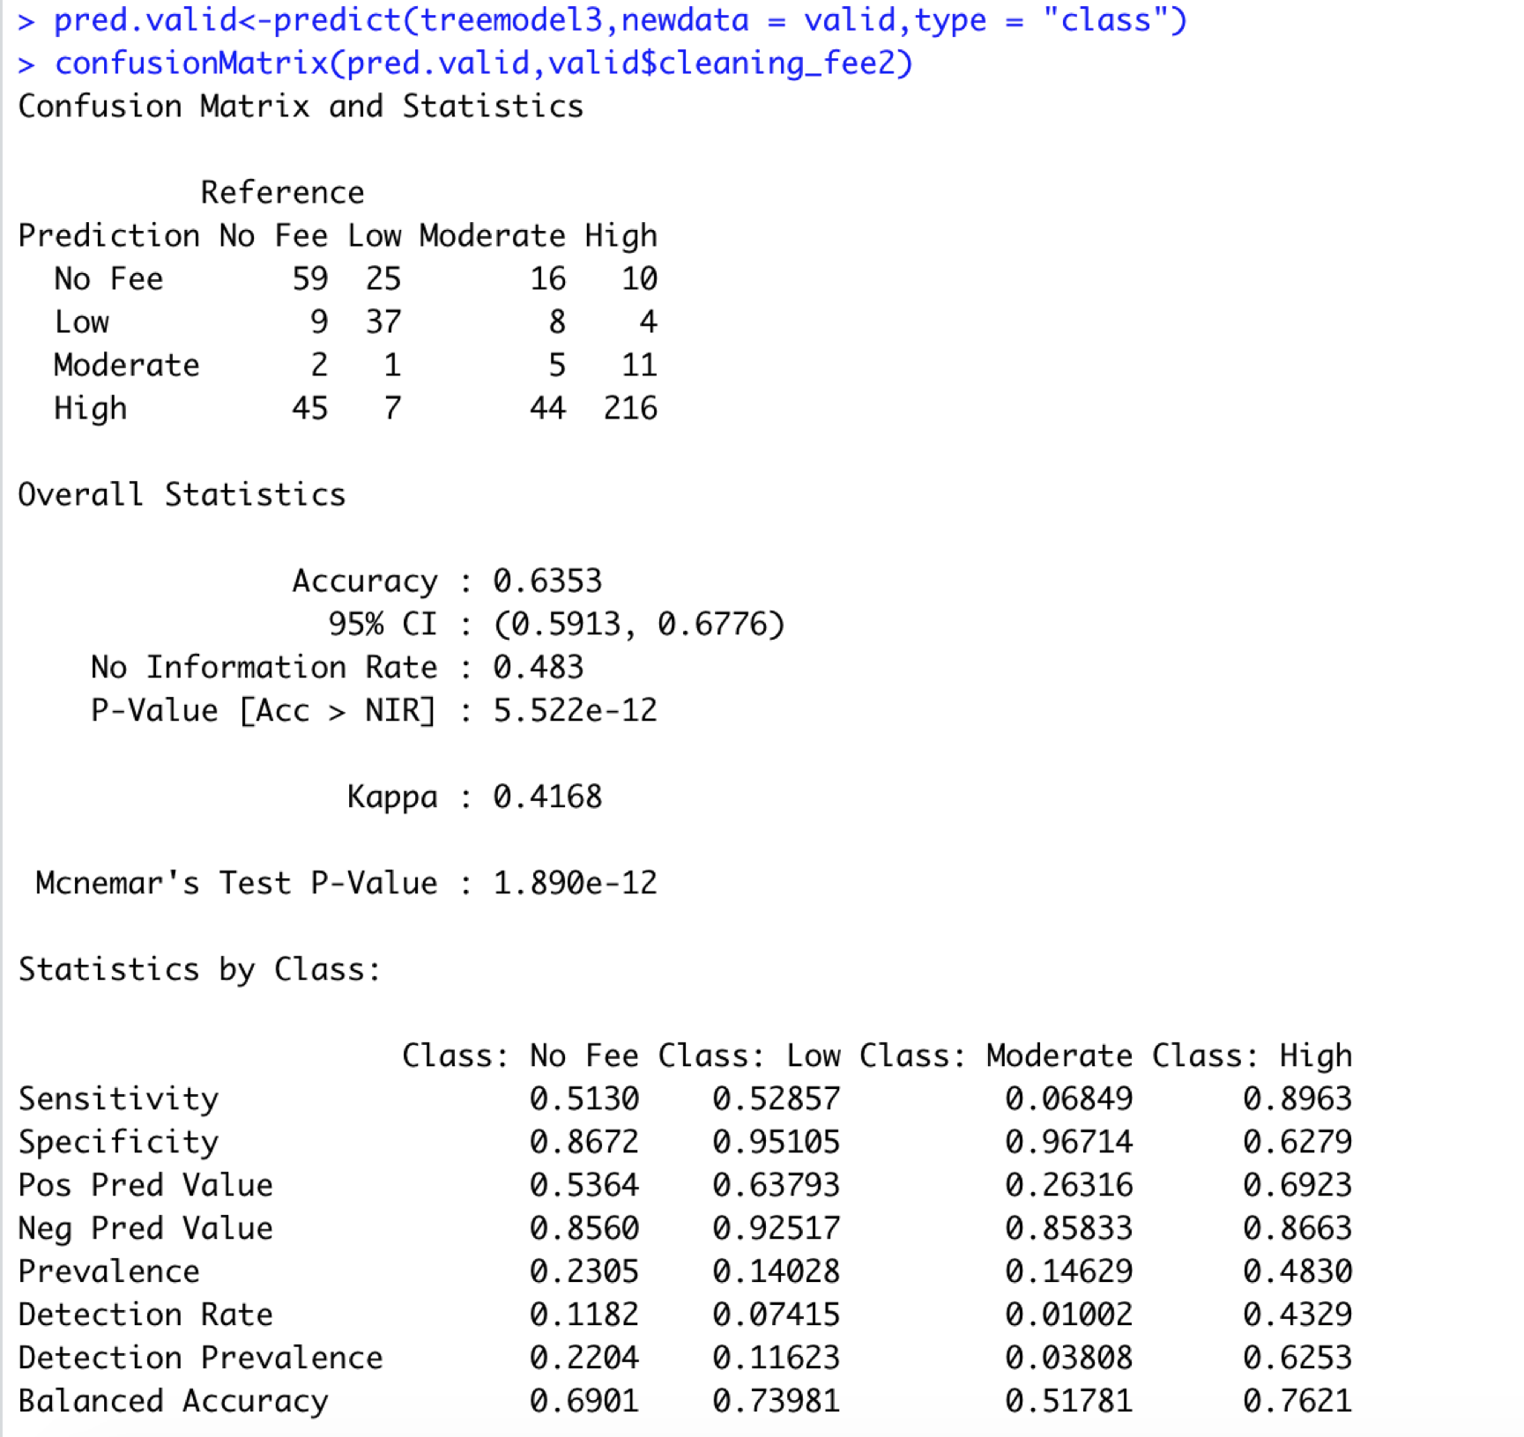
Classification
Classification Tree - Assess the tree
67%
64%
Notes:
2min30s

Slide 28
Clustering
4

Slide 29
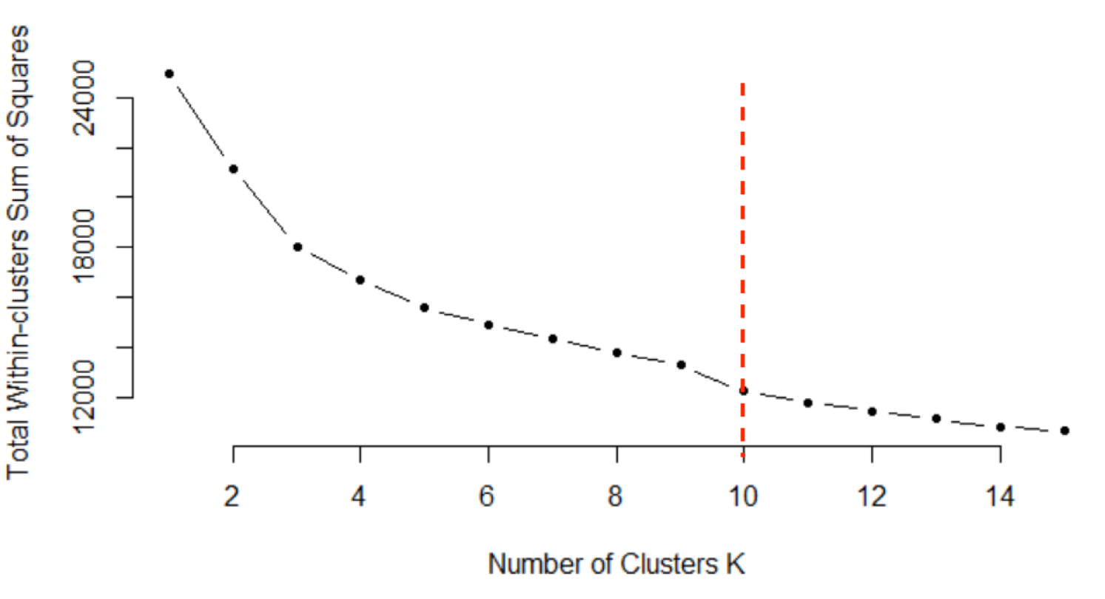
Clustering
Data Preprocessing:
Normalization on the selected numerical variables
Selecting k clusters:
Elbow Chart

Slide 30
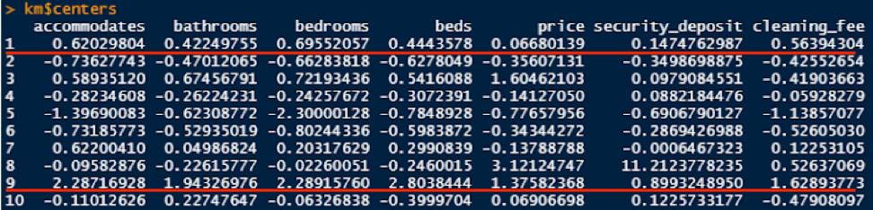
Clustering
Fun Time:
Cluster 1: Families. High accommodates, bathrooms, bedrooms, beds
Cluster 9: Herd. Even higher accommodates, bathrooms, bedrooms, beds
Notes:
1min30s

Slide 31
Conclusion
5

Slide 32

Conclusion
How can these models be useful? Who could benefit from these models?
For hosts, to pinpoint their Airbnb property features
For Airbnb, to classify their hosts

Slide 33
THANK YOU
FOR YOUR PATIENCE!

